Slide 1
Analytical Methods for Business
Dr. Ronald K. Satterfield
Muma College of Business
University of South Florida

Slide 2
Multiple Regression Explaining More
Dr. Ronald K. Satterfield
Muma College of Business
University of South Florida

Slide 3

Plan for This Presentation
Comparison w/ Simple Regression
Explaining More Variation
Basic Examples
Assumptions
Non-Linear Relationships
Categorical Independent
Introduction | Background | Examples
Variable Transforms | Binary Variables | Conclusion

Slide 4



Multiple Regression
Introduction | Background | Examples
Variable Transforms | Binary Variables | Conclusion

Slide 5


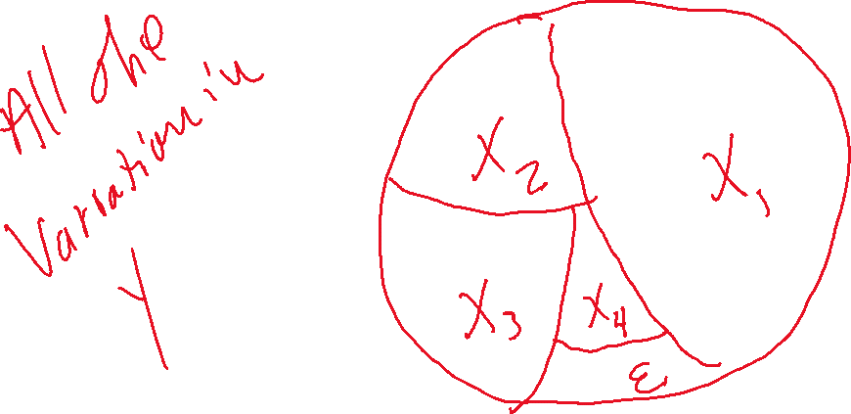
A Graphical Representation
Introduction | Background | Examples
Variable Transforms | Binary Variables | Conclusion
Notes:
5

Slide 6
“Explaining” Variation
Introduction | Background | Examples
Variable Transforms | Binary Variables | Conclusion
Notes:
6

Slide 7
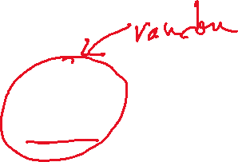
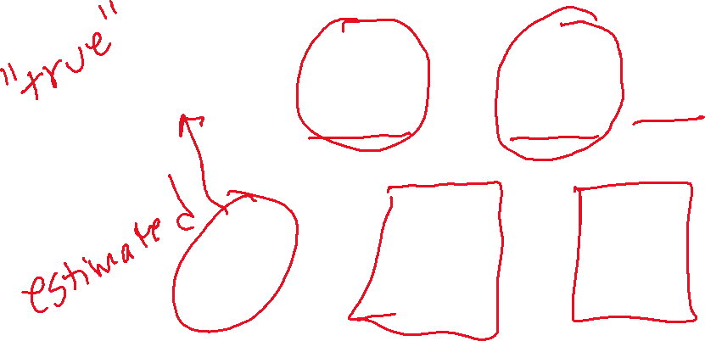


Simple Regression Models
Introduction | Background | Examples
Variable Transforms | Binary Variables | Conclusion
Notes:
7

Slide 8



Multiple Regression Models
Introduction | Background | Examples
Variable Transforms | Binary Variables | Conclusion
Notes:
8

Slide 9

Warehouse Cost
Data Set: Warehouse Cost
Introduction | Background | Examples
Variable Transforms | Binary Variables | Conclusion

Slide 10

Conducting a Multiple Regression Analysis
Data Set: MPG
Introduction | Background | Examples
Variable Transforms | Binary Variables | Conclusion
Notes:
10

Slide 11
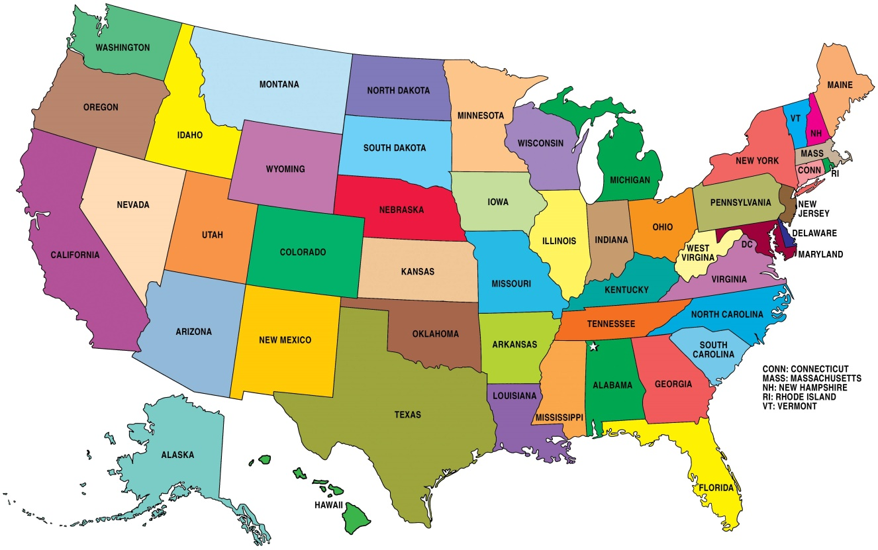

Revisiting a Data Set
Data Set: Child Abuse with Binaries
Introduction | Background | Examples
Variable Transforms | Binary Variables | Conclusion
Notes:
11

Slide 12
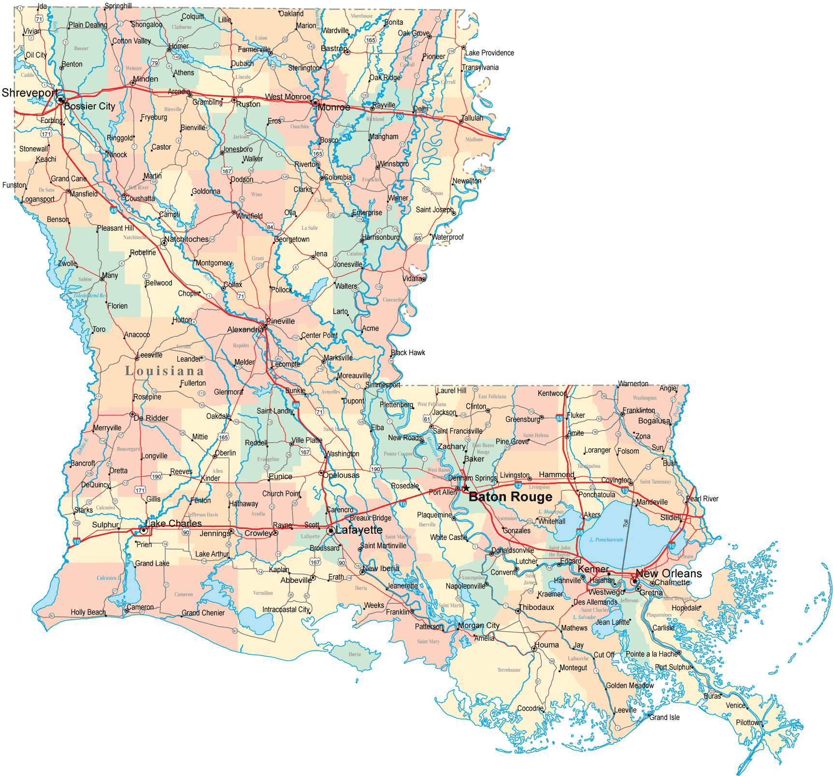

Revisiting a Data Set
Data Set: Child Abuse with Binaries
Introduction | Background | Examples
Variable Transforms | Binary Variables | Conclusion
Notes:
12

Slide 13

More Independent Variables
Data Set: House Appraisals
Introduction | Background | Examples
Variable Transforms | Binary Variables | Conclusion
Notes:
13

Slide 14
Conducting a Multiple Regression Analysis
Data Set: House Appraisals
Multiple Independent Variables
More About Binary Variables
Introduction | Background | Examples
Variable Transforms | Binary Variables | Conclusion
Notes:
14

Slide 15
Conclusion
Introduction to Multiple Regression
Comparison w/ Simple Regression
Basic Examples
Assumptions
Non-Linear Relationships
Categorical Independent
Introduction | Background | Examples
Variable Transforms | Binary Variables | Conclusion

